Slide 1
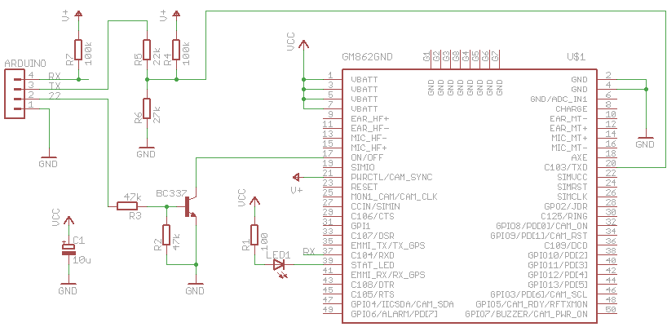
GSM Module
1. Schematic (GM862 to Arduino)

Slide 2
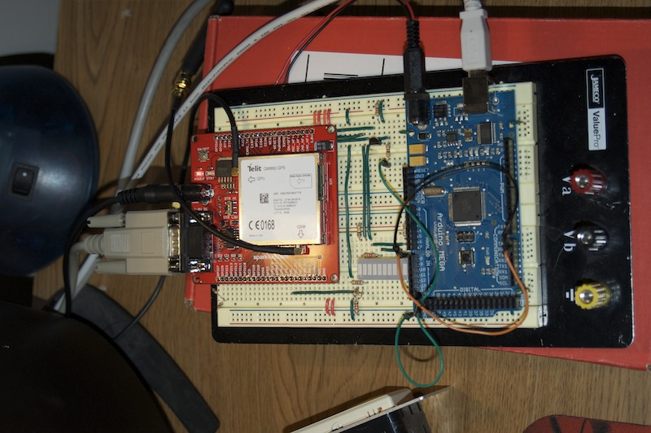
GSM Module
2. Hardware

Slide 3
GSM Module
3. Hardware
Serial over USB
5V Power
UART
Serial
5V Power
GM862
Arduino
Mega
RS232

Slide 4
GSM Module
4. Software (Current capabilities)
Connect and communicate with GM862 using RS232 connection
Receive and send SMS text messages
Query web addresses
Identify own IP address and port communication
Send data via TCP/IP connection

Slide 5
GSM Module
5. To do
Server Communication over TCP/IP
  Authorization
  Watchdog
Website Interface
  Google Maps Integration
  Control Commands
  Status updates
SMS Text Message Parsing

